Slide 1
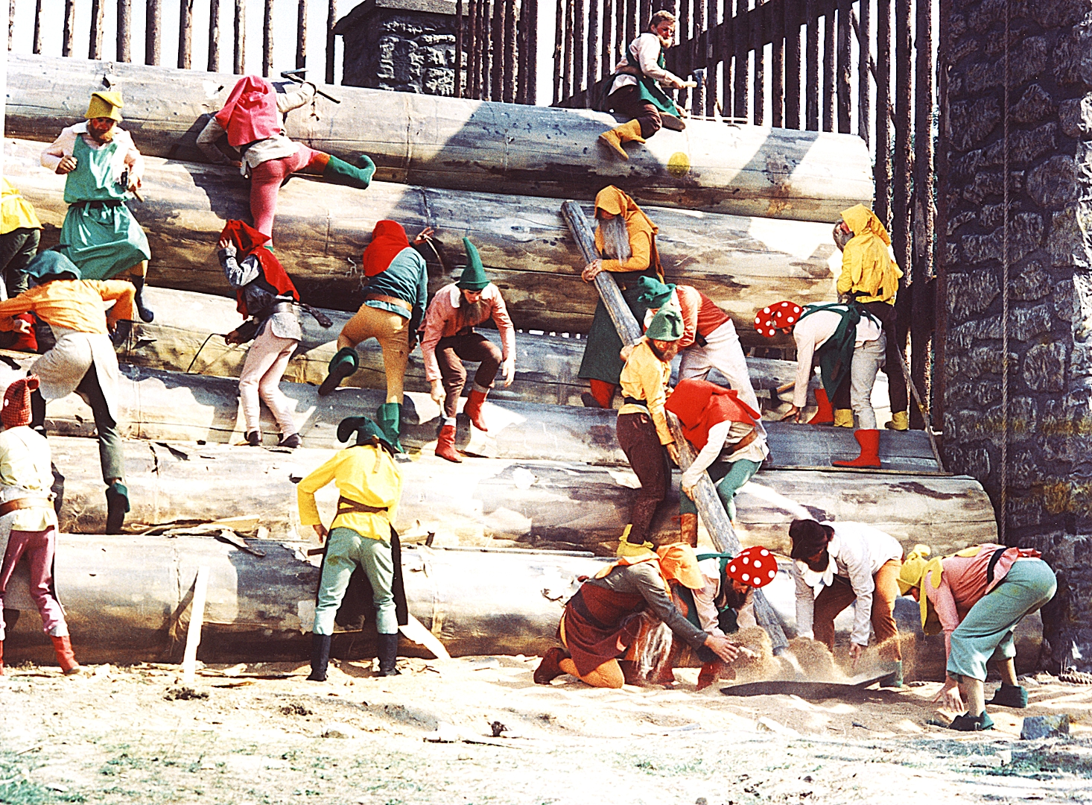
Async programming in Python Pt.1
pkral78

Slide 2
Brief history – stone age
PEP 234 (2001) -- Iterators
In computer programming, an iterator is an object that enables a programmer to traverse a container, particularly lists
Iterable object – must implement __iter__
Iterator – must implement __next__
Simplified case, object both act as iterator and iterable (make it non-reentrant)
StopIteration exception

Slide 3
Brief history – stone age
PEP 255 (2001) – Simple Generators
Python 2.2
aka Generator Iterators (in fact they implements iterator protocol)
Introduce statement yield arg
Yield pauses and save execution frame for later resume
Calling function with yield statement actually returns generator (which IS iterator)

Slide 4
Brief history – middle age
PEP 342 (2005) – Enhanced Generators
Python 2.5, EG aka Coroutines
yield became expression
Introduce send(arg) method on generators
This allows pass arg back to paused generator i.e. gime = yield give
send(arg) is like next with argument
throw(type, value, tb) pass exception
close() == self.throw(GeneratorExit)

Slide 5
Brief history – middle age
PEP 380 (2009) – Delegating Subgenerators
Python 3.3
yield from <expr>
Allows refactor generator into separate functions and chaining them without explicit iteration
Basically value/exception pass through caller-chain-generator is handled automatically

Slide 6
What‘s the purpose?
Coroutine has ability to suspend its execution point and let caller to continue its program flow
This makes execution flow non-linear (i.e. no simple call-return nesting)
Coroutines makes possible to handle asynchronous events in imperative way
(at opposite to use callback base approach)

